Slide 1
Hardware
Mack 2021

Slide 2
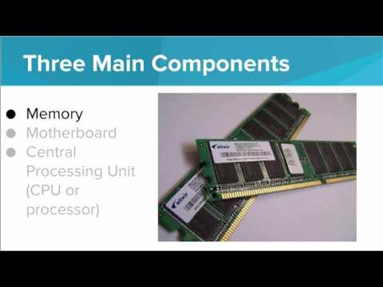
We learn about what computer hardware is and how it works.

Slide 3
Which of the following choices lists the three main components of a computer’s hardware?
Notes:
🍐 This is a Pear Deck Multiple Choice Slide. Your current options are: A: CPU, Memory, Motherboard, B: CPU, Flash memory, Processor, C: Processor, Binary, RAM, D: Input devices, Output devices, Motherboard,
🍐 To edit the type of question or choices, go back to the "Ask Students a Question" in the Pear Deck sidebar.
A

Slide 4
What does CPU stand for?
Notes:
🍐 This is a Pear Deck Multiple Choice Slide. Your current options are: A: Computer’s Processing Unit, B: Computer’s Plug-in Unit, C: Central Processing Unit, D: Central Pushing Unit,
🍐 To edit the type of question or choices, go back to the "Ask Students a Question" in the Pear Deck sidebar.
C

Slide 5
Which of the following devices is the device that connects all of the physical components of a computer together?
Notes:
🍐 This is a Pear Deck Multiple Choice Slide. Your current options are: A: CPU, B: Memory, C: Logic, D: Motherboard,
🍐 To edit the type of question or choices, go back to the "Ask Students a Question" in the Pear Deck sidebar.
D

Slide 6

Choose the option that correctly identifies this picture:
Notes:
🍐 This is a Pear Deck Multiple Choice Slide. Your current options are: A: CPU, B: RAM, C: CD, D: Operating System,
🍐 To edit the type of question or choices, go back to the "Ask Students a Question" in the Pear Deck sidebar.

Slide 7
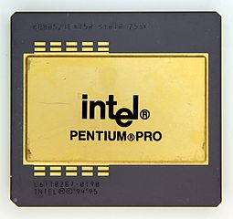
Choose the option that correctly identifies this picture:
Notes:
🍐 This is a Pear Deck Multiple Choice Slide. Your current options are: A: CPU, B: Motherboard, C: CD, D: Operating System,
🍐 To edit the type of question or choices, go back to the "Ask Students a Question" in the Pear Deck sidebar.

Slide 8
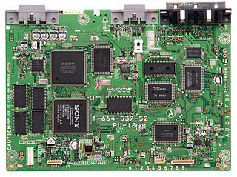
Choose the option that correctly identifies this picture:
Notes:
🍐 This is a Pear Deck Multiple Choice Slide. Your current options are: A: CPU, B: Motherboard, C: CD, D: Operating System,
🍐 To edit the type of question or choices, go back to the "Ask Students a Question" in the Pear Deck sidebar.

Slide 9
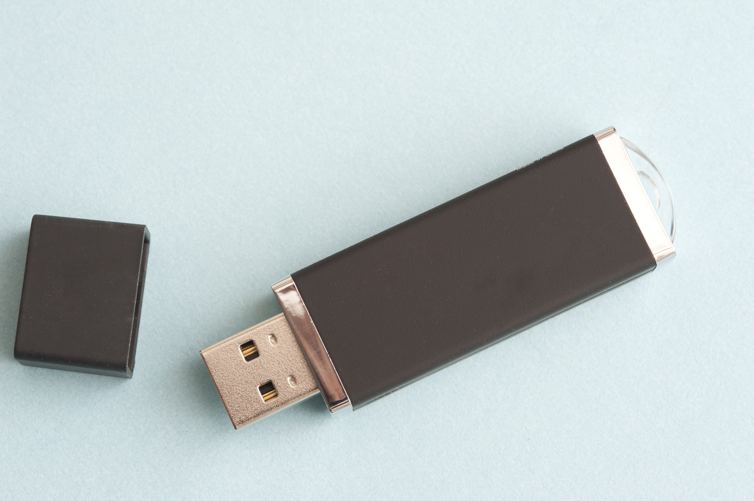
Choose the option that correctly identifies this picture:
Notes:
🍐 This is a Pear Deck Multiple Choice Slide. Your current options are: A: CPU, B: Motherboard, C: USB drive, D: CD,
🍐 To edit the type of question or choices, go back to the "Ask Students a Question" in the Pear Deck sidebar.

Slide 10
Label Your Computer
Get some sticky notes.
Use a sticky note to label each easily accessible hardware part of your computer.
Compare your sticky notes with your neighbor’s. Do your labels match?
Once you have completed the activity, write 2-3 sentences describing anything you found surprising, interesting, or confusing.

Slide 11
Computer Analogy
The three main parts of a computer are the CPU, Memory, and Motherboard. Imagine you are explaining what a computer is to a kindergarten student. What analogy could you use to explain the hardware parts of a computer?

Slide 12
Hardware vs. Software
Compare and contrast hardware and software.
List three to five differences.
Then, list three to five similarities.

